Slide 1



Welcome to
Governors State University

Slide 2

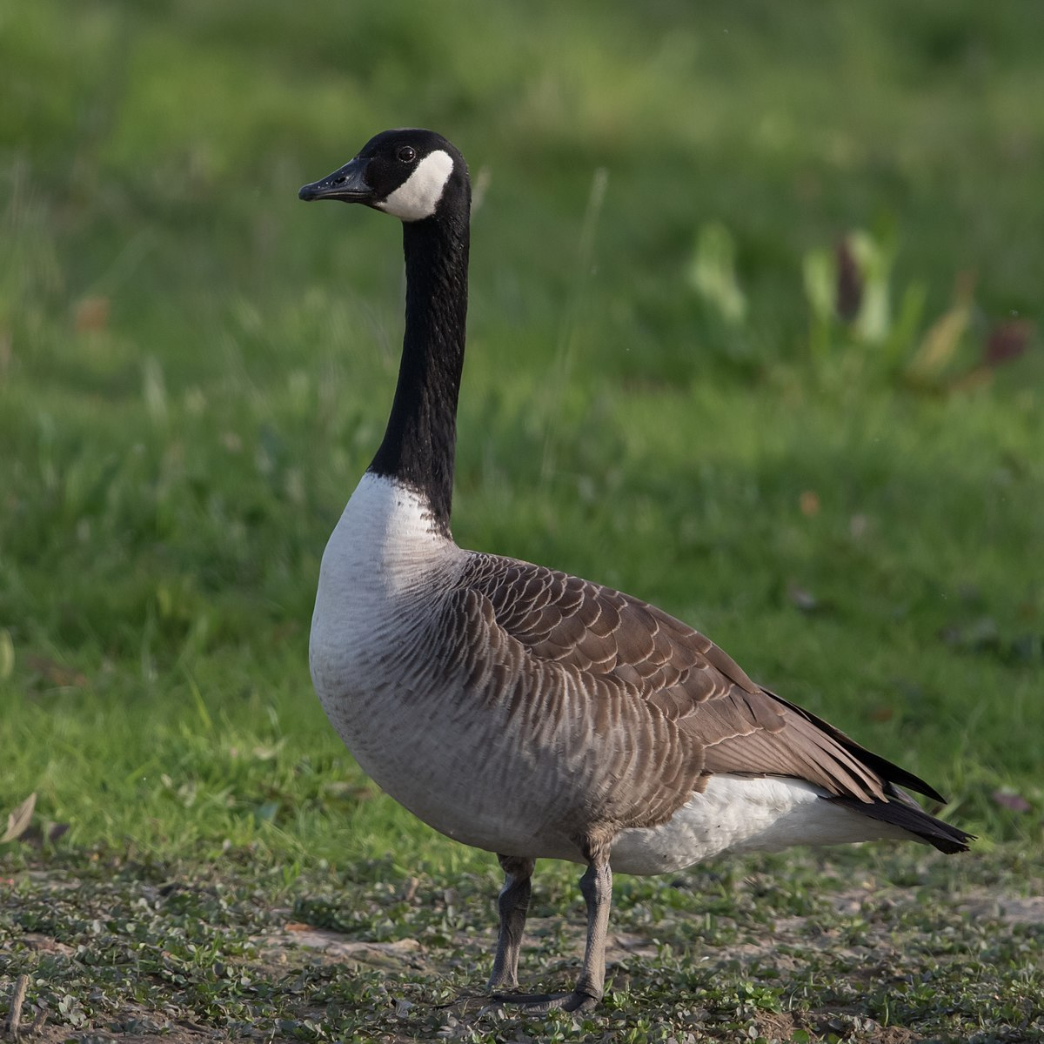
GovState Trivia
How tall is the Paul Bunyan Statue located across from Prairie Place?
25 feet
What is the most commonly seen bird on campus?
Goose
What year did GovState welcome the first class of four-year freshman?
2014

Slide 3

What is Admitted Student Day?
Establish a personal connection with our freshman students with GSU staff
Prepare students for enrollment steps – Today’s Actionable Items
Complete the deposit process
Learn more about Freshman Orientation
Prepare students to apply for housing
Confirm eligible students for the Honors College
Review the financial aid process
Early step in establishing a community and INCREASE STUDENT SUCCESS!

Slide 4
Fast Facts on GovState
62,000+ alumni
750-acre campus
80+ student organizations and clubs
4,338 students enrolled
12:1 student to faculty ratio
24 countries represented
#1 safest campus in Illinois
(www.niche.com/colleges/search/safest-colleges/s/illinois/?type=public)
#8 safest campus in U.S.
(backgroundchecks.org/50-safest-colleges-in-america.html)

Slide 5
Top Undergraduate Majors
Accounting, BS
Nursing, BSN
Communication, BA
Community Health, BHS
Elementary Education, BA;
English, BA;
Information Technology, BS
Interdisciplinary Studies, BA
Psychology, BA
Business Administration, BA
Criminal Justice, BA
Social Work, BSW

Slide 6
Top Graduate Majors
5. Communication Disorders, MHS
Educational Administration, MA
Counseling, MA
Occupational Therapy, MOT
Accounting, MS
Computer Science, MS
Social Work, MSW
Health Administration, MHA
Physical Therapy, DPT

Slide 7



Quality
73% rate overall experience as excellent or good*
101 average pages of assigned writing in the first year*
80% complete high-impact practices*
61.5% of GSU students receive grants and scholarships
International students from over 24 different countries
*National Survey of Student Engagement 2018
Nationally Recognized by US News and World Report
2022 Social Mobility
2022 Online Undergraduate Business Programs
2021 Ethnic Diversity
2021 Student Debt Load at Graduation – Least Debt
2021 Undergraduate Business Programs
2021 Undergraduate Computer Science Programs

Slide 8
First Year Experience

Slide 9


First Year Experience
As a GovState Freshman, you will…
-Declare an area of academic interest
-Be placed in 1 of 7 First Year Focus Areas to complete general education courses
-Work with an academic advisor who will help you develop a full-time schedule structured to ensure you succeed
-Attend classes capped at 30 students
-Learn with academic peers
-Transition into a program that best meets your needs

Slide 10

7 Focus Areas of Study
DISCOVERY
Undecided? You’re not alone! About 1/3 of all Bachelors-level students change majors in the first 3 years. Explore options under guided expertise to save money and time.
EDUCATION
Secondary Education (Biology, Chemistry, Mathematics, English}, Early Childhood Education, Elementary Education
BUSINESS
Business Administration, Entrepreneurship, Health Administration, Accounting
ARTS & ENTERTAINMENT
Fine Arts, Media Studies, Theater and Performance Studies
HUMANITIES
English, History
SOCIAL & BEHAVIORAL SCIENCES
Anthropology, Sociology, Communication, Criminal Justice, Economics, Political Science, Psychology, Social Work
STEM
Biology, Chemistry, Communication Disorders, Community Health, Computer Science, Information Technology, Mathematics, Nursing

Slide 11

First Year Experience
Lock-in your tuition rate
Make your $50 Enrollment Deposit!
-$50 Deposit is applied directly towards your first semester’s tuition bill
-Secures your place in GovState’s LIMITED Freshman class

Slide 12
Get Involved!
Cultural
Association of Latin American Students
Black Student Union
Chinese Student Association
Coalition of Occupational Therapy Advocates for Diversity
International Culture Organization
Service
Kaleidoscope
Social Work Student Organization
Student Senate
Honor Societies
Alpha Iota Sigma Honors Society
Beta Gamma Sigma Honors Society
Kappa Delta Pi Honors Society
Pi Alpha Alpha Honors Society
Psi Chi Psychology Honors Society
Tau Sigma National Honors Society
Greek Life
Alpha Psi Lambda
Alpha Kappa Alpha (“The Divine Nine”)
General Interest
Accounting Club
Drone Engineering Club
GovState Cheer Squad
GovState Dance Company
GovState Psychology Club
Jaguars Anime and Gaming Club
Jaguar Drill Team
GovState Thespian Troupe
Hall of Faith
Ladies of Virtue and Excellence
National Student Speech/Hearing Assoc.
PT Student Association
Reconstructed
Student Education Association
Student Healthcare Management Assoc.
Student OT Association
Student Veterans Association
…and you can always start a new club!

Slide 13



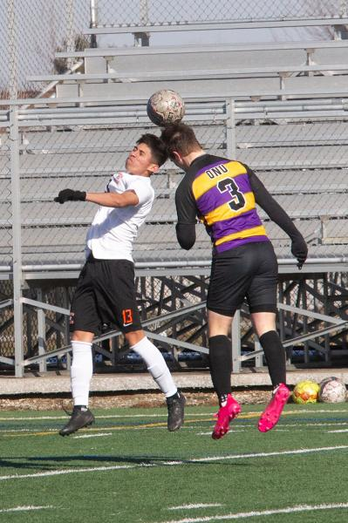

Become a Jaguar!
NAIA Collegiate Teams
-Men’s and Women’s Basketball
-Men’s and Women’s Cross Country & Track
-Men’s and Women’s Golf
-Men’s and Women’s Soccer
-Men’s and Women’s Volleyball
-Women’s Bowling
- Esports
Varsity Reserve Teams:
-Men’s and Women’s Basketball
-Men’s and Women’s Soccer
-Men’s and Women’s Volleyball

Slide 14

Applying for Housing
3 room types, 3 meal plan options.
The application for Fall 2026 housing will open sometime in March. Please contact Housing with any questions about the process.
Apply online at: www.govst.edu/housing
Email: housing@govst.edu
Phone: (708) 235-7110

Slide 15

Financing
Your Education

Slide 16

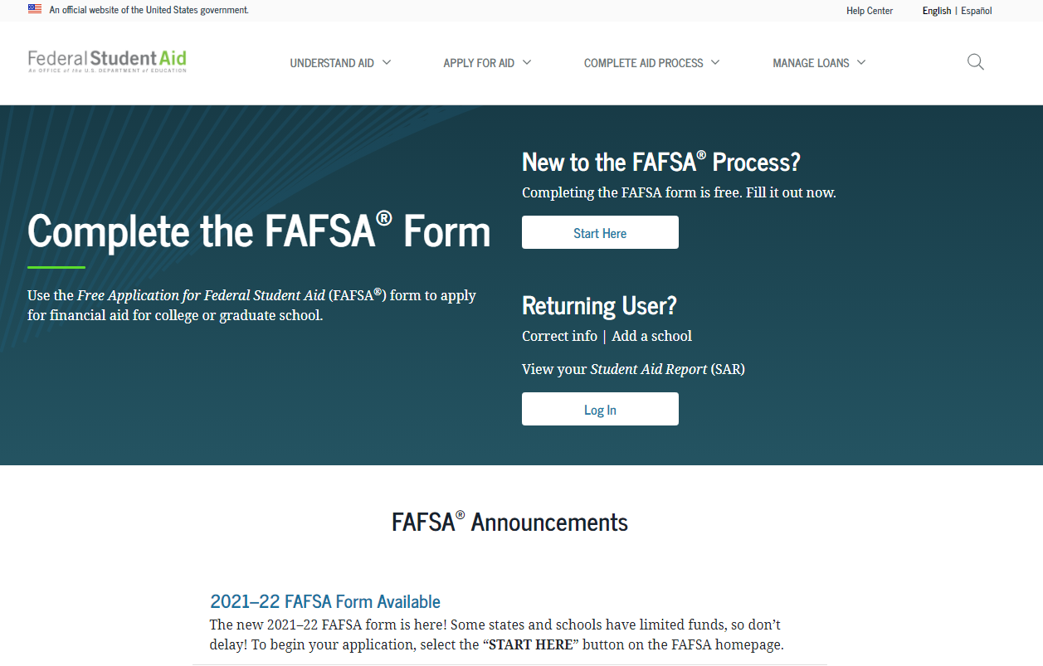
How do I apply for Financial Aid?
Starts with the #FAFSA!
(Free Application for Federal Student Aid)

Slide 17

Types of Financial Aid
1. Grants
2. Loans
3. Scholarships
4. Student Employment Opportunities

Slide 18

Grants
Federal PELL Grant
Illinois MAP Grant
Federal SEOG Grant
TEACH Grant

Slide 19

Student Loans
Federal Direct Loan
-Subsidized
-Unsubsidized
-PLUS
Private Student Loans

Slide 20
Scholarships
GSU Scholarship homepage: www.govst.edu/Scholarships/
Scholarship Universe: govst.scholarshipuniverse.com/public
With Scholarship Universe, Students will be able to:
• Answer questions and match to scholarship opportunities they are eligible for
• Easily apply online to multiple scholarship opportunities through a personalized portal
• See scholarship metrics to determine their chances and effort required to apply
• Be alerted whenever they are matched to new scholarship opportunities
• Receive automated reminders about outstanding tasks and next steps

Slide 21
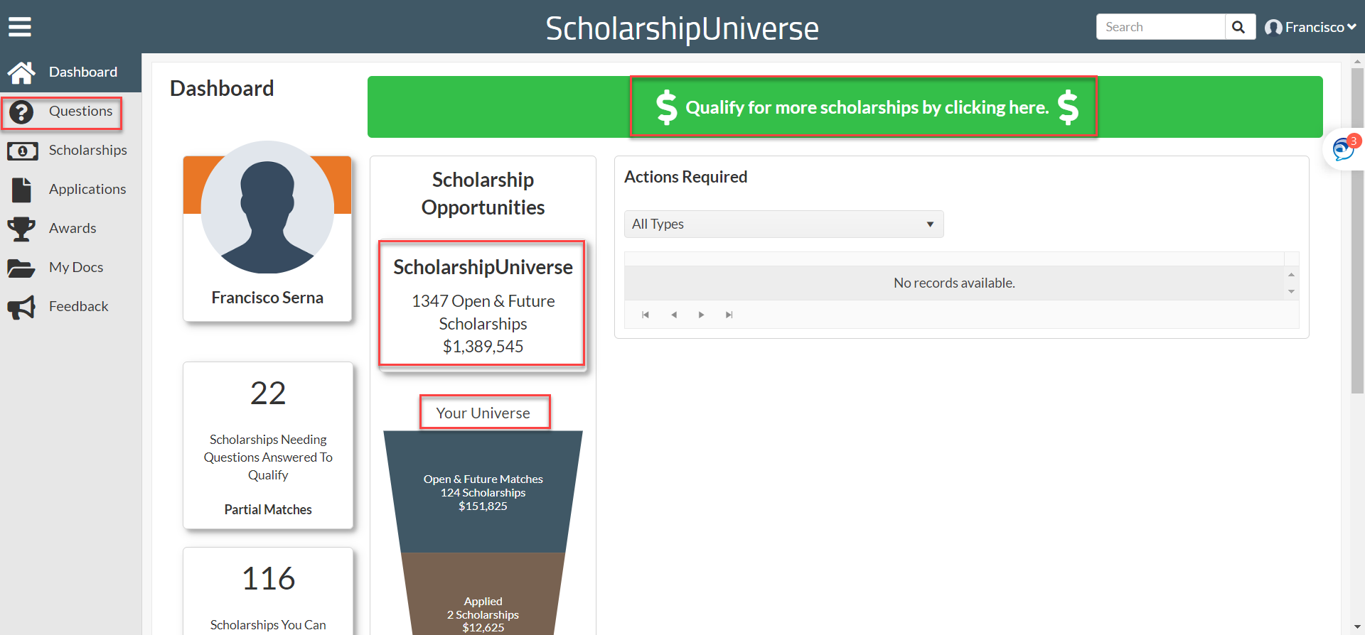
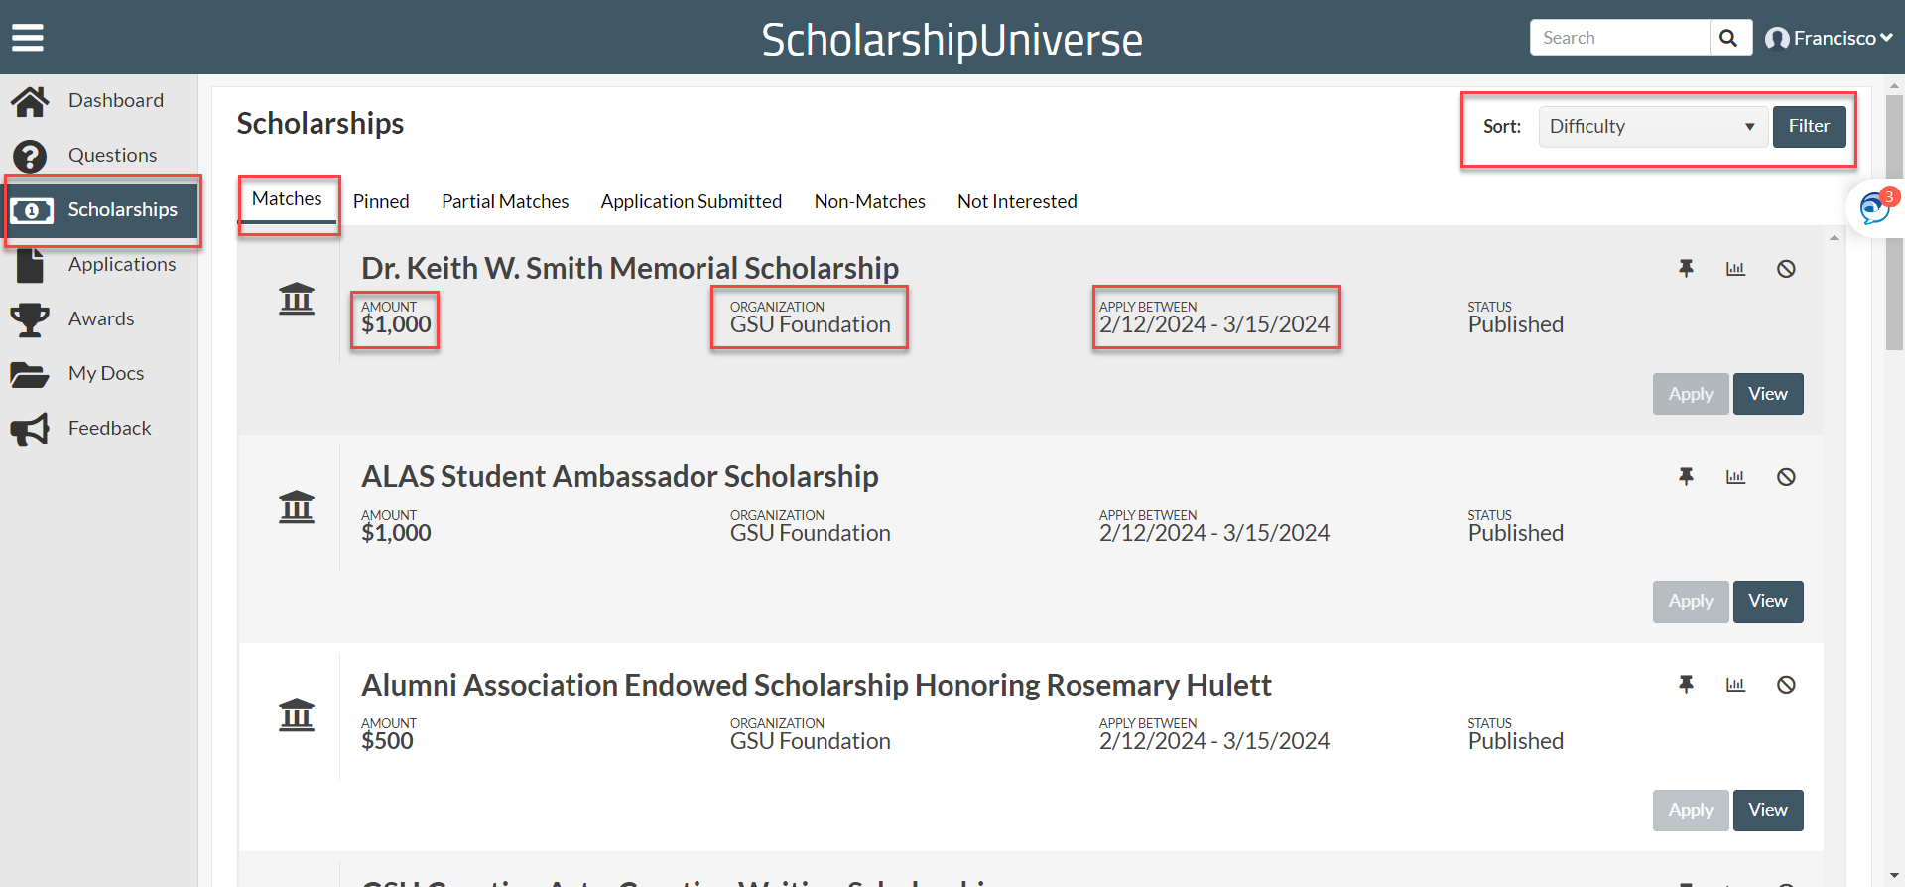
SCHOLARSHIP UNIVERSE

Slide 22

Federal Work Study
Employment on or off campus
Minimum wage or higher
Gain valuable work experience
Work up to 30 hours per pay period

Slide 23
AIM HIGH – First Year Students
HIGH SCHOOL
TIER 1
GPA | 3.5+
Award Amount | $5000 per year
TIER 2
GPA | 2.75 to 3.49
Award Amount | $3000 per year
GPA Threshold
Scholarship
HS GPA: 3.5 – 4.0 $5,000 annually
HS GPA: 3.0 – 3.49 $3,000 annually
Notes:
*Students must complete AIM HIGH Confirmation form as well as submit $50 enrollment deposit to secure scholarship

Slide 24
AIM HIGH Criteria
To qualify for AIM HIGH, students must:
Have attended an Illinois high school.
Be enrolled full time in a baccalaureate degree program at Governors State University for the first time.
Be a resident of Illinois.
Be a U.S. Citizen or eligible non-citizen.
Not have household income that exceeds eight times the poverty rate.
Meet full admissions criteria.
Not yet have earned a baccalaureate degree or 135 undergraduate credit hours.
Not be in default of student loans or owe a refund or repayment of state or federal grants or scholarships
Scholarship

Slide 25
AIM HIGH RETENTION
To remain qualified after the first year, you must:
Continuously enroll as a full-time student (at least 12 credit hours) at GSU for Fall and Spring semesters.
Maintain Financial Aid Satisfactory Academic Progress (SAP) as outlined by the SAP Policy.
Maintain a cumulative 2.5 institutional grade point average at GSU.
Submit the FAFSA or Alternative Application for Illinois Financial Aid each year you are enrolled at GSU.

Slide 26
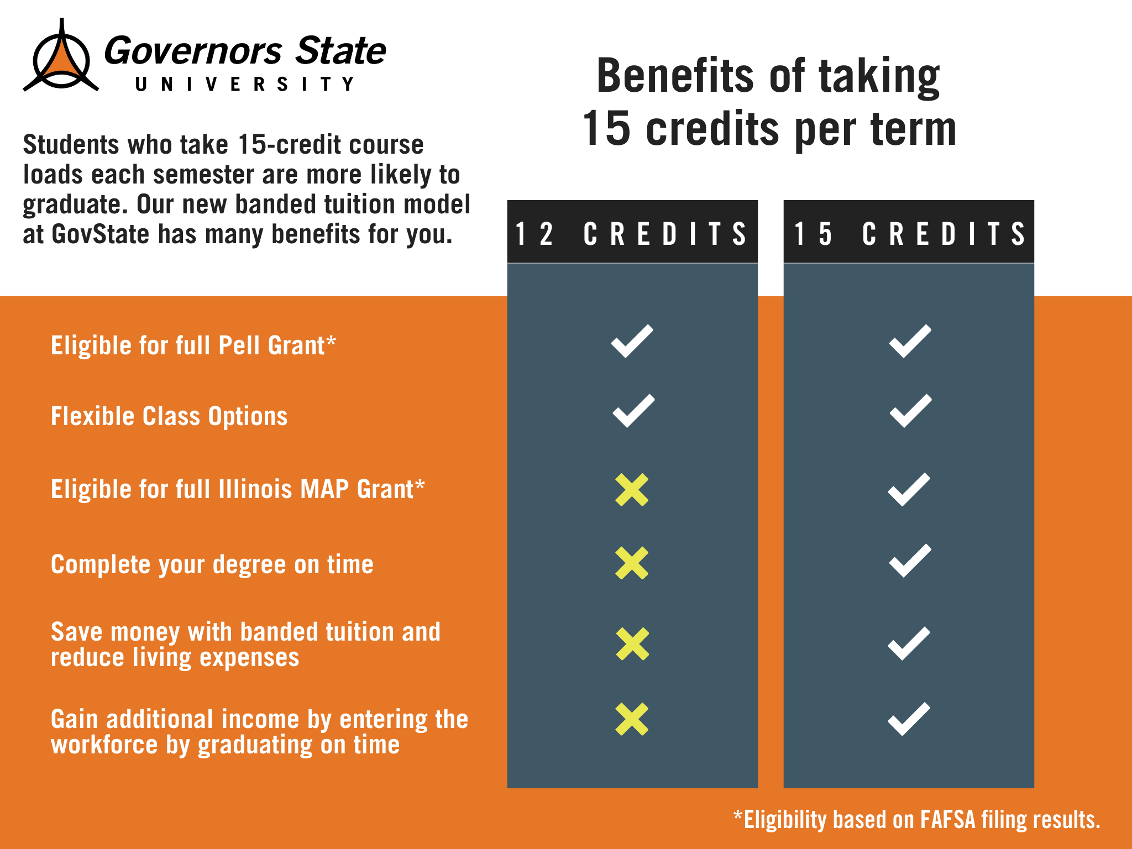
Banded Tuition
Allows students to be charged the same tuition if you are taking 12 credit hours or more!

Slide 27
Tuition and Fees 2025-2026
 | Non- Residential Cost (Living Off-Campus) | Residential Cost (Tuition, Fees, Room and Board)
Part-Time (1-11 credit hours per semester) | $373 per credit hour | Semi-Suite plus Silver meal: (Up To) $20,008
Full-Time (12 credit hours and beyond) | $15,356 per academic year | Semi-Suite plus Silver meal: $23,114

Slide 28
Office of Financial Aid
Phone: (708) 534-4480
Email: faid@govst.edu
Website: www.govst.edu/financialaid/

Slide 29
Honors College Experience

Slide 30
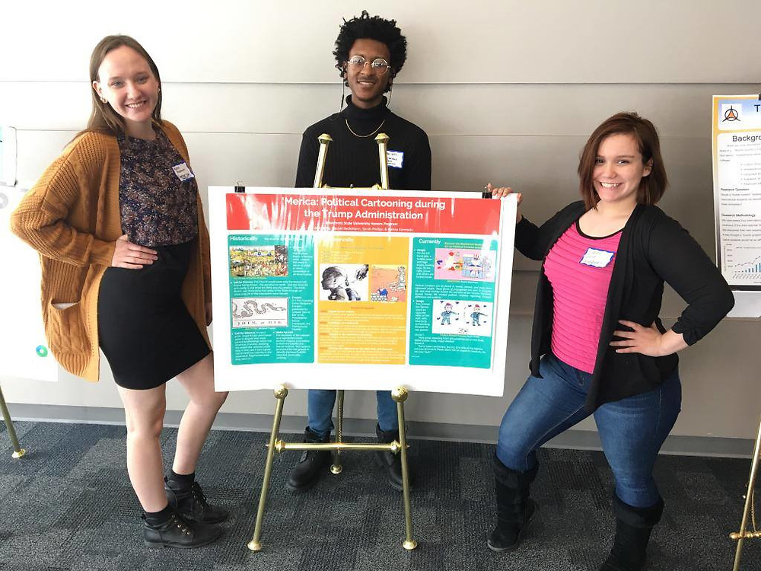
What is different about
University Honors?
Innovation
Leadership
Creating Initiatives
Community Building

Slide 31
GPATH - Guaranteed Graduate
Admissions Pathway
Start as a freshmen honors student
Finish first semester with 3.5+ GovState GPA
Second semester receive an invite to join GPATH
Retention standards apply each semester
Can still apply to GSU grad school programs through normal means if GPATH spot not retained

Slide 32
GPATH - Guaranteed Graduate
Admissions Pathway
Student gains faculty and track adviser in one of ten graduate programs.
Business – All Grad Programs (4)
Health & Human Services – OT, PT, CDIS, Informatics
Arts & Sci – Biology, Chemistry
Support for career planning, course planning, grad school readiness

Slide 33
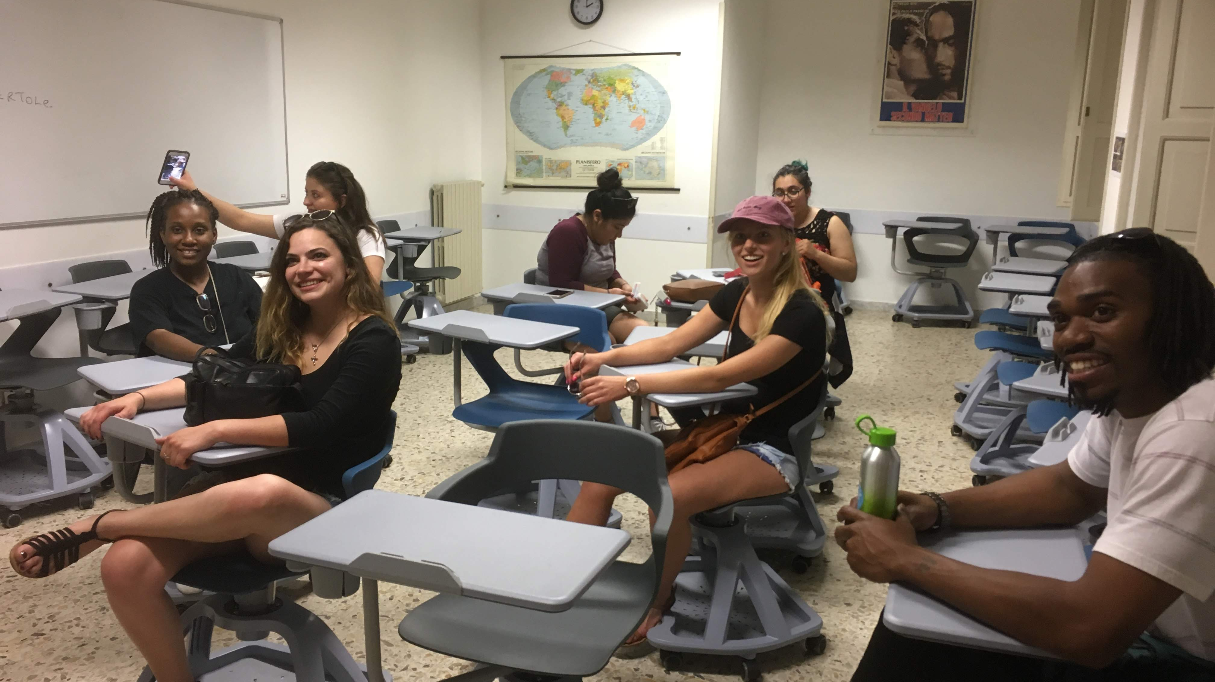
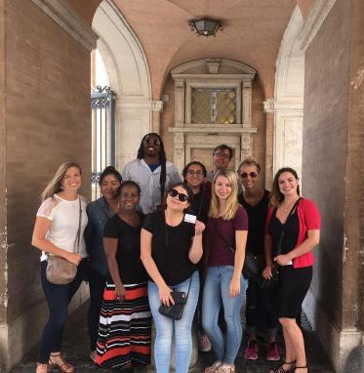

Honors Study Abroad in Rome, Italy

Slide 34

Contact Information
Dr. David Rhea, PhD
Dean, Honors College
drhea@govst.edu

Slide 35
Admitted Freshman Checklist

Slide 36
Admitted Freshman Checklist
Get started on your journey as a Jaguar by activating your myGSU portal: You can find your login information on your admission acceptance letter.
Complete the Free Application for Federal Student Aid (FAFSA): at www.FAFSA.gov to qualify for all types of financial aid. Use GSU’s school code—009145—to make sure we receive your financial aid information.
Complete Placement Exams: Students in STEM majors need to complete placement before attending orientation.
Complete Freshman Orientation: Your journey as a GovState student begins with Freshman Orientation! We have transitioned to an in-person or online format– access through the myGSU portal.
Submit your Immunization records via MedProctor. www.medproctor.com by the start of your first semester or when you move into on-campus housing.
Submit the Freshman Enrollment Deposit: Submit your deposit today!

Slide 37
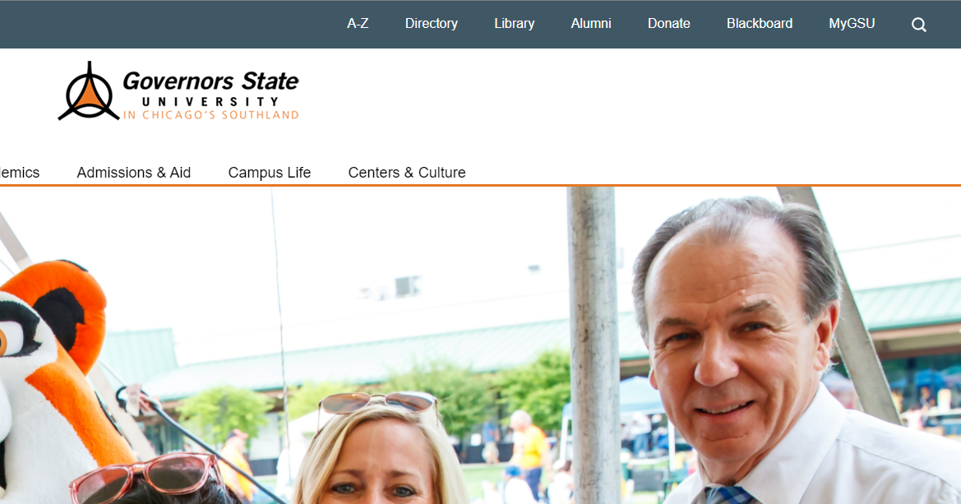
Accessing myGSU
Step 1: Go to the main webpage: www.govst.edu
Step 2: Navigate to the myGSU Student Portal.

Slide 38

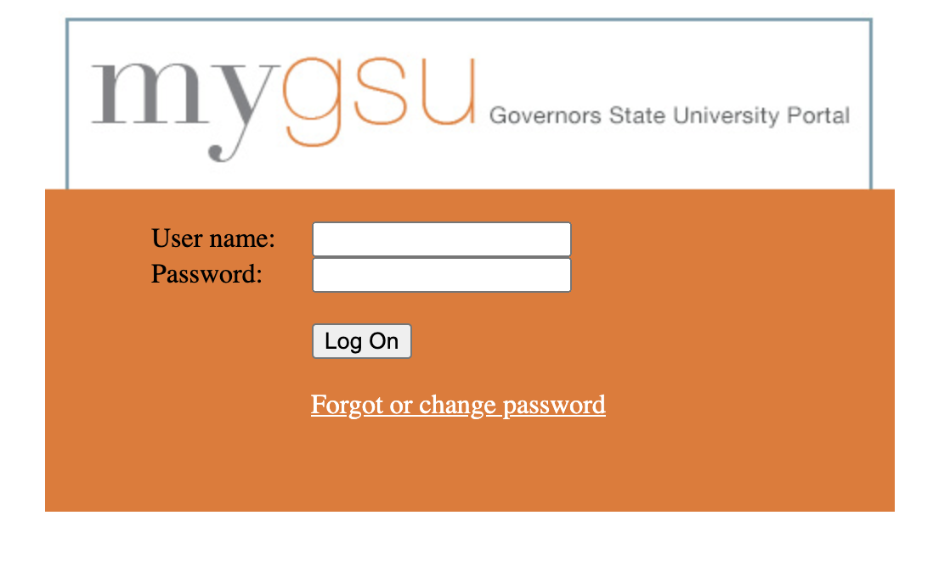
Accessing myGSU
Step 3: Refer to your Admission acceptance letter where you can find your GovState credentials.
Step 4: Enter your student credentials

Slide 39
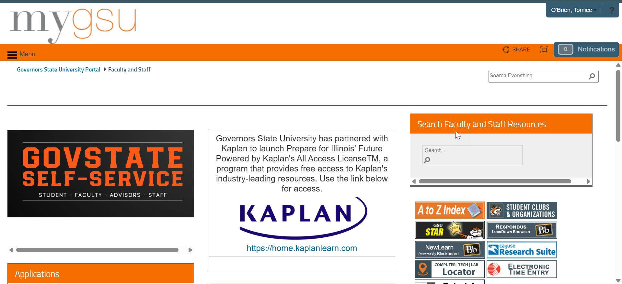

Slide 40
Accessing Financial Aid
Step 1: Navigate to the myGSU Student Portal.

Slide 41
Accessing Financial Aid
Step 2: Log-in with your credentials, which can be found on your Acceptance Letter.

Slide 42
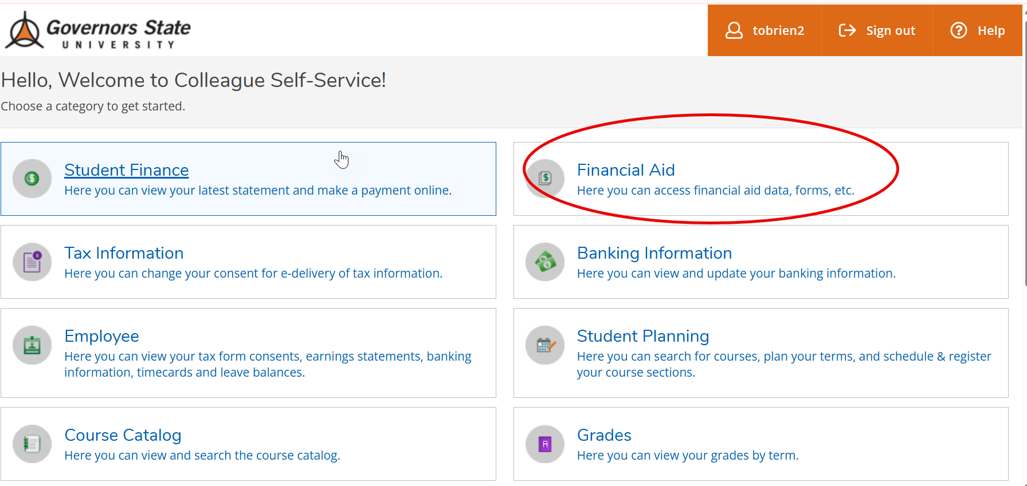
Accessing Financial Aid
Step 3: Under the Online Services, go to the Students tab. Click on Financial Aid then My Financial Aid to see your award amounts.

Slide 43
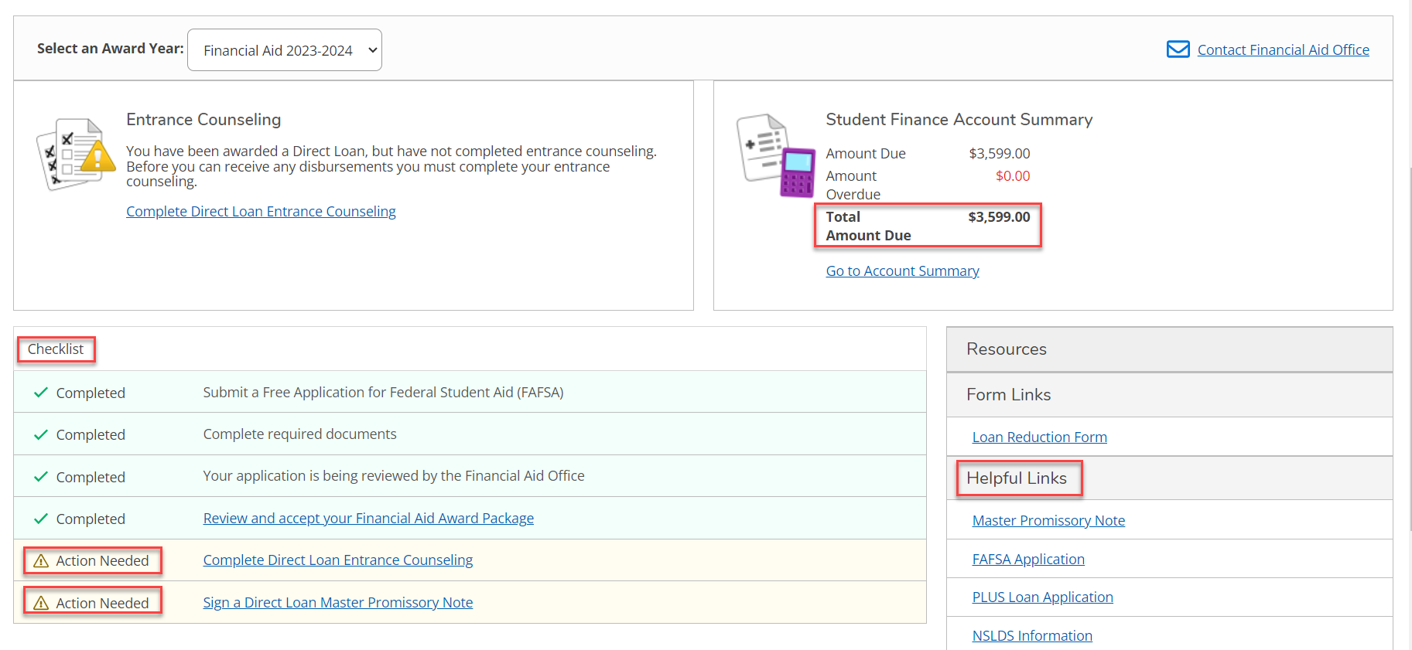
Award Letter Example

Slide 44
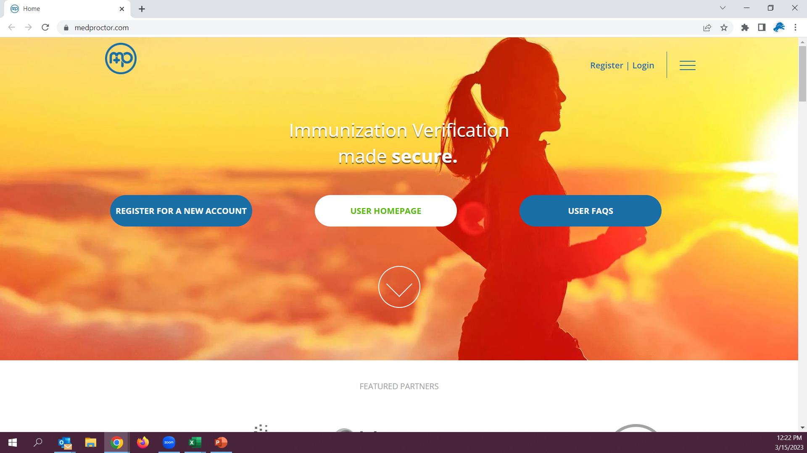
Submitting Immunizations
Step 1: Go to MedProctor website at www.medproctor.com.

Slide 45
Submitting Immunizations
Step 2: Click “register” and create an account using your GovState student email address.

Slide 46
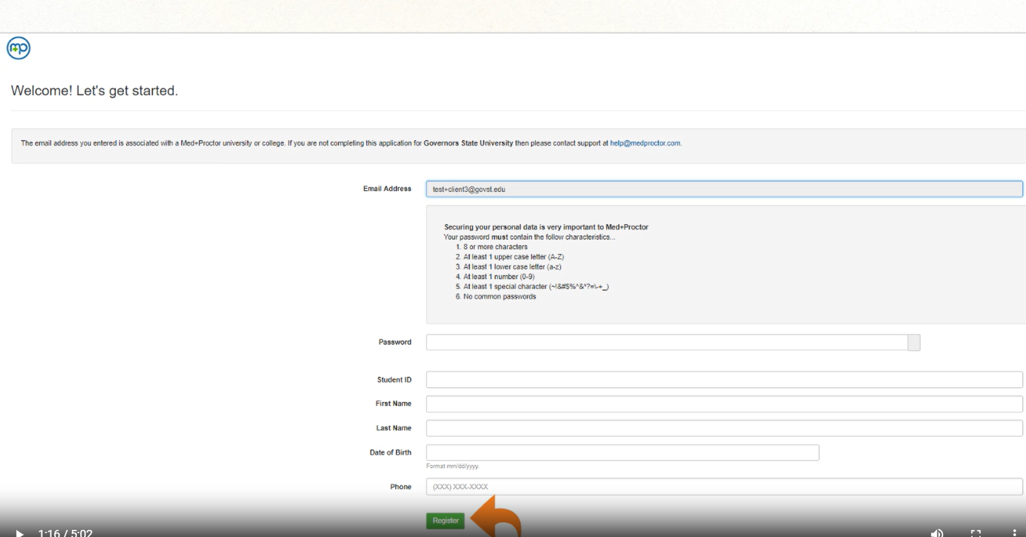
Submitting Immunizations
Step 3: Complete your MedProctor Profile.

Slide 47
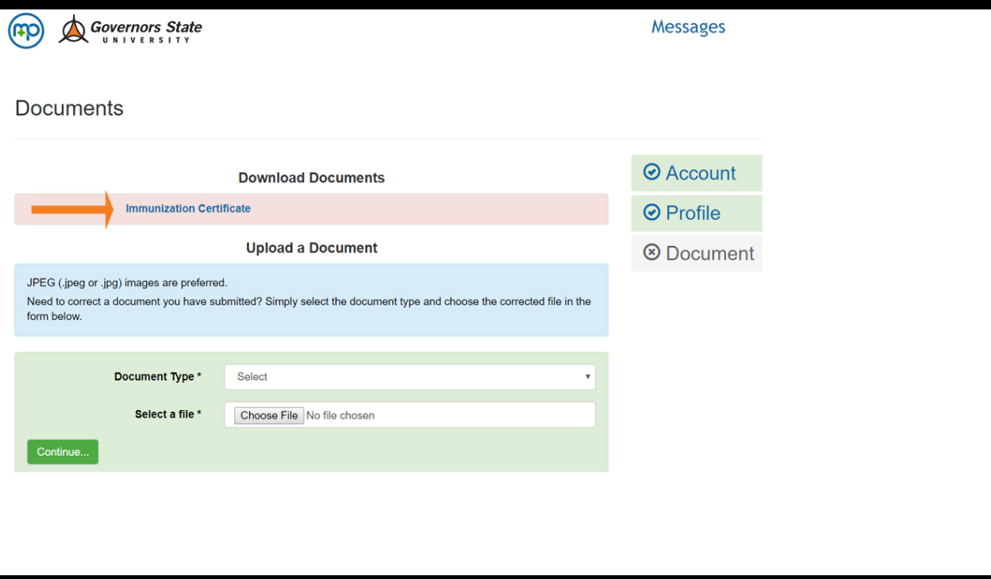
Submitting Immunizations
Step 4: Download and Print the Immunization Certificate.

Slide 48
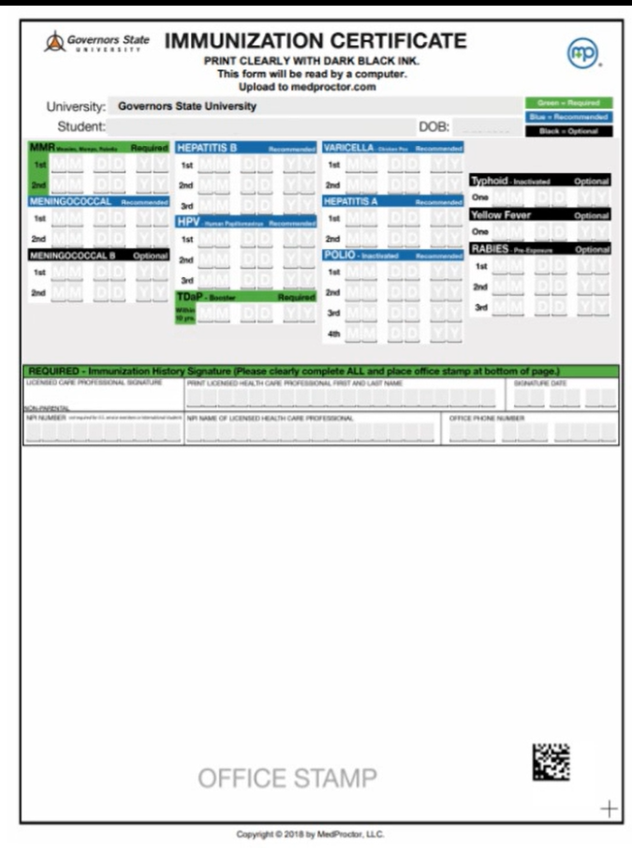
Submitting Immunizations
Step 5: Take the Immunization Certificate form to your medical provider for completion.

Slide 49
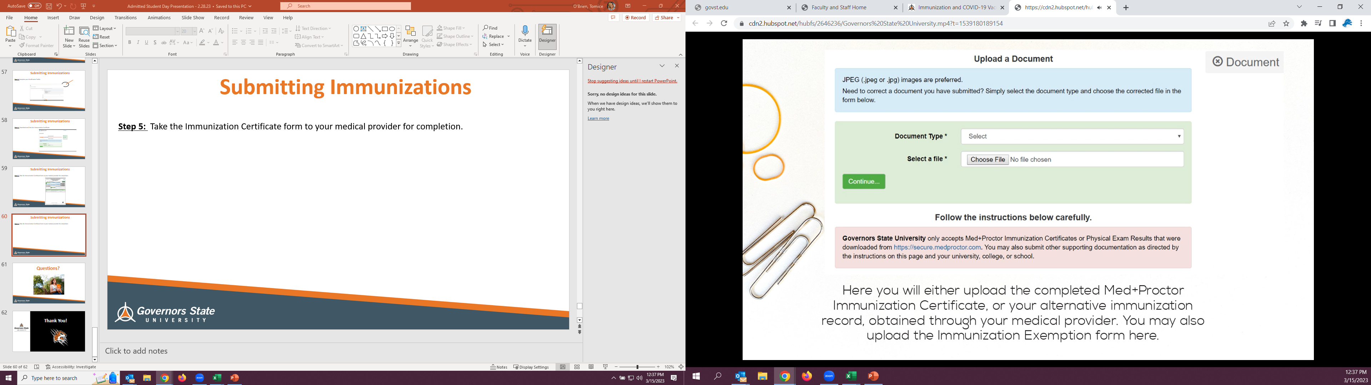
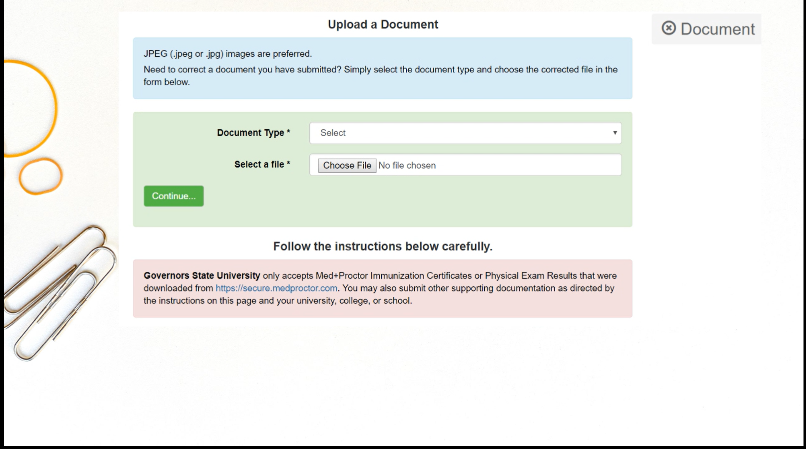
Submitting Immunizations
Step 6: Upload your Immunization Certificate Form to MedProctor.

Slide 50
Submitting Immunizations
NOTE: Immunization Record Compliance Deadlines:
Students admitted Fall: September 1
Students admitted Spring: February 1
Students admitted Summer: July 1
For more information about Immunizations, please visit www.govst.edu/immunizations or watch the tutorial video.

Slide 51

Placement Testing
Student in STEM, Business and Education focus areas need to complete placement ahead of attending ROAR orientation.
Registration is online at www.aleks.com or in our Testing Center.
Placement score requirements will be listed in the catalog.
Testing Center:
GMT Building
708.235.7555
testingcenter@govst.edu

Slide 52
Freshman Enrollment Deposit
$50 Freshman Enrollment Deposit
Credited to your student account – pre-payment on first semester’s tuition
Saves your seat in Governors State’s limited Freshman Class

Slide 53
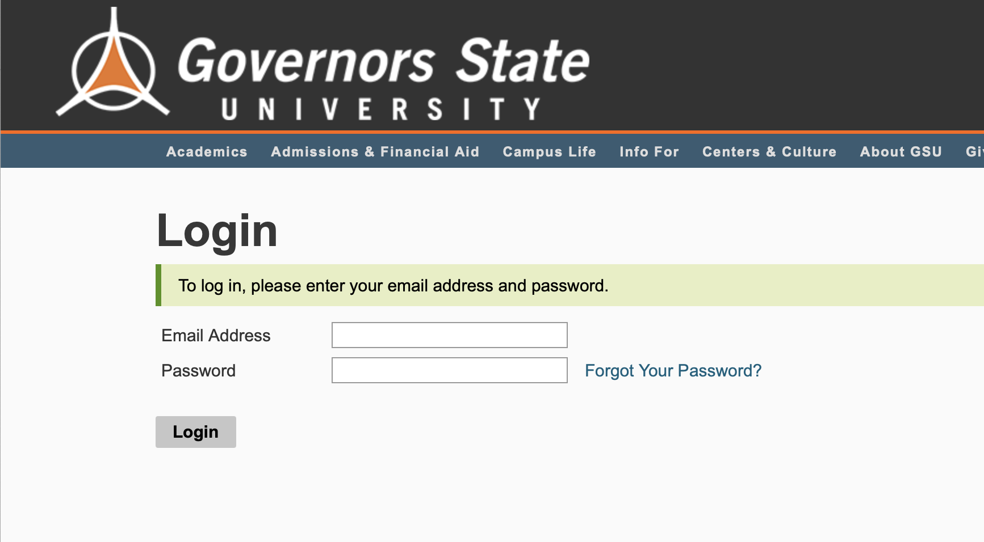
How to Deposit
Step 1: Student can now deposit in the Application Portal
apply.govst.edu/apply/status

Slide 54
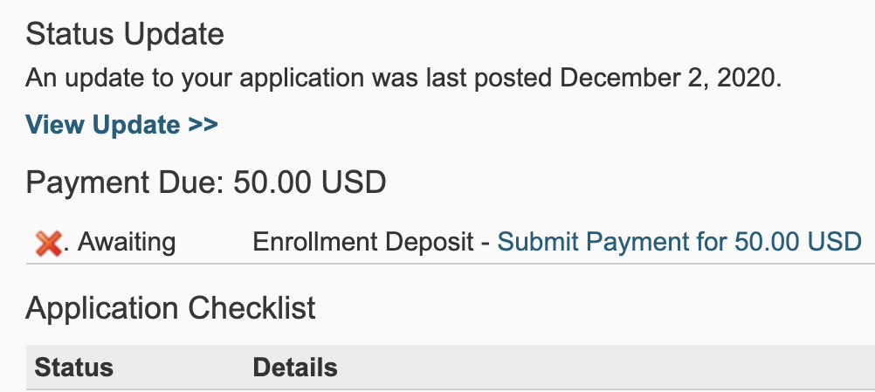
How to Deposit
Step 2: Under Status Update, you will see ‘Submit Payment for 50.00 USD’

Slide 55
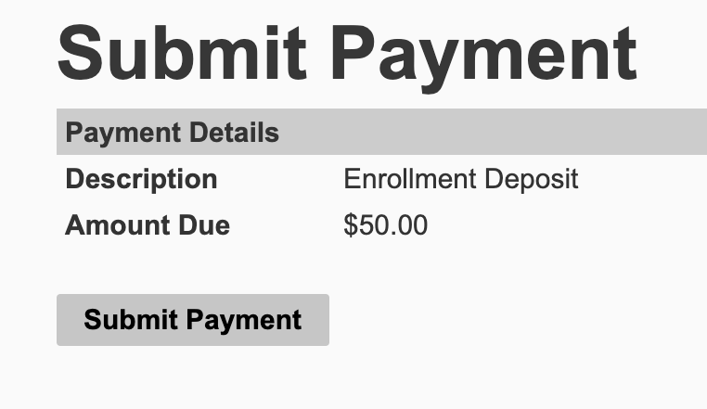
How to Deposit
Step 3: You will receive a screen that reads ‘Submit Payment’, click the button to continue

Slide 56
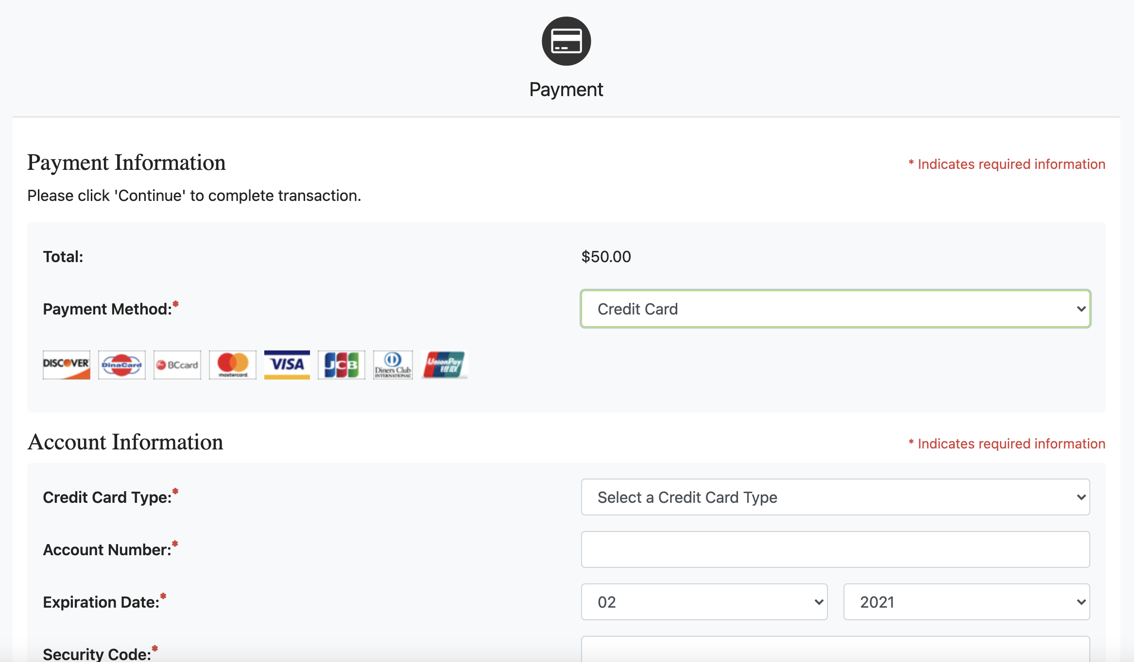
How to Deposit
Step 4: You will be logged into the secure TouchNet Payment Center to submit your Enrollment Deposit

Slide 57
Admitted Freshman Checklist
Get started on your journey as a Jaguar by activating your myGSU portal: You can find your login information on your admission acceptance letter.
Complete the Free Application for Federal Student Aid (FAFSA): at www.FAFSA.gov to qualify for all types of financial aid. Use GovState’s school code—009145—to make sure we receive your financial aid information.
Complete Placement Exams: Students in STEM majors need to complete placement before attending orientation.
Complete Freshman Orientation: Your journey as a GovState student begins with Freshman Orientation! We have transitioned to an in-person or online format– access through the myGSU portal.
Submit your Immunization records via MedProctor. www.medproctor.com by the start of your first semester or when you move into on-campus housing.
Submit the Freshman Enrollment Deposit: Submit your deposit today!

Slide 58

Questions?

Slide 59


Thank You!
body

